Slide 1


March Data Crunch Madness
Team Orange
Yichen Pan Ziyue Zhong Haojunzhi Yu Teena George
March 21, 2018

Slide 2
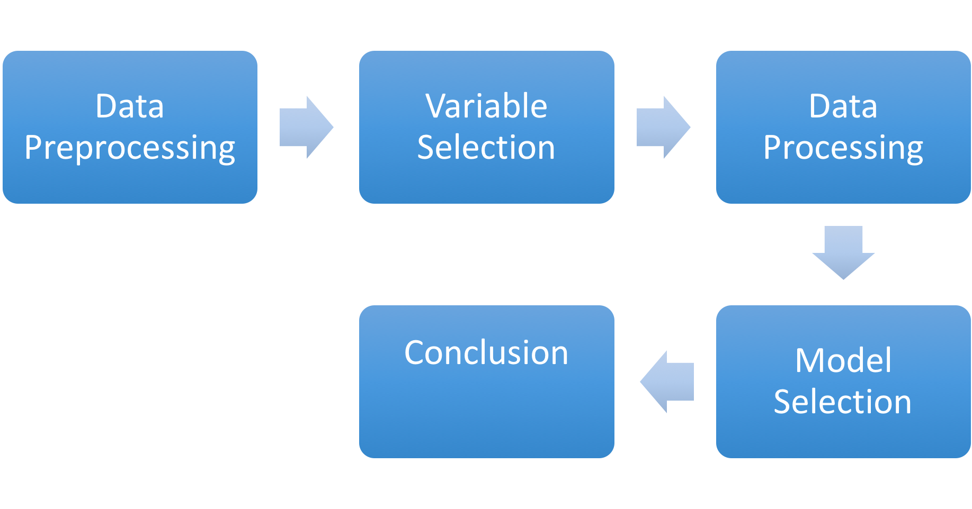

Procedures

Slide 3
Data Pre-processing
Process Missing value by using average RPI rating from all other variables
Add variables from other sources (https://www.sports-reference.com/cbb/)
Normalize data by using normalize function from sklearn.preprocessing package in python

Slide 4
Added Variables
Variables | Calculation
Log 5 | P(W)=(E(A%)–E(A%)E(B%))/(E(A%)+E(B%)–2E(A%)*E(B%))
E(W%) | E(W%)=Adjoe^13.9/(Adjoe^13.9 + Adjde^13.9)
EFG-OEFG | Effective Field Percentage - Opponent Effective Percentage
TPP-DTPP | Turnover Committed per Possession – Defensive Rebounding Caused per Possession
SRS | Simple Rating System
SOS | Strength of Schedule
Adj_win | (0.8*Home Win + 1.2*Away Win + Host Win)/Total Games
Host_win | Host wining percentage

Slide 5
Coach Influence
Coach Influence Calculation:
Step 1: Select variables:
Coach season win% = season win / (season loss+ season win)
Coach career win%(at current school) = career win/ (career loss + career win)
Career overall number of NCAA Tournament appearances
Career overall number of NCAA Final Four appearances
RPI rating
Step 2: Use selected variables to do correlation analysis
Step 3: Distribute weight to each variable (90 to win%/10 to appearances) based on coefficient
Step 4: Calculate coach influence for each team

Slide 6
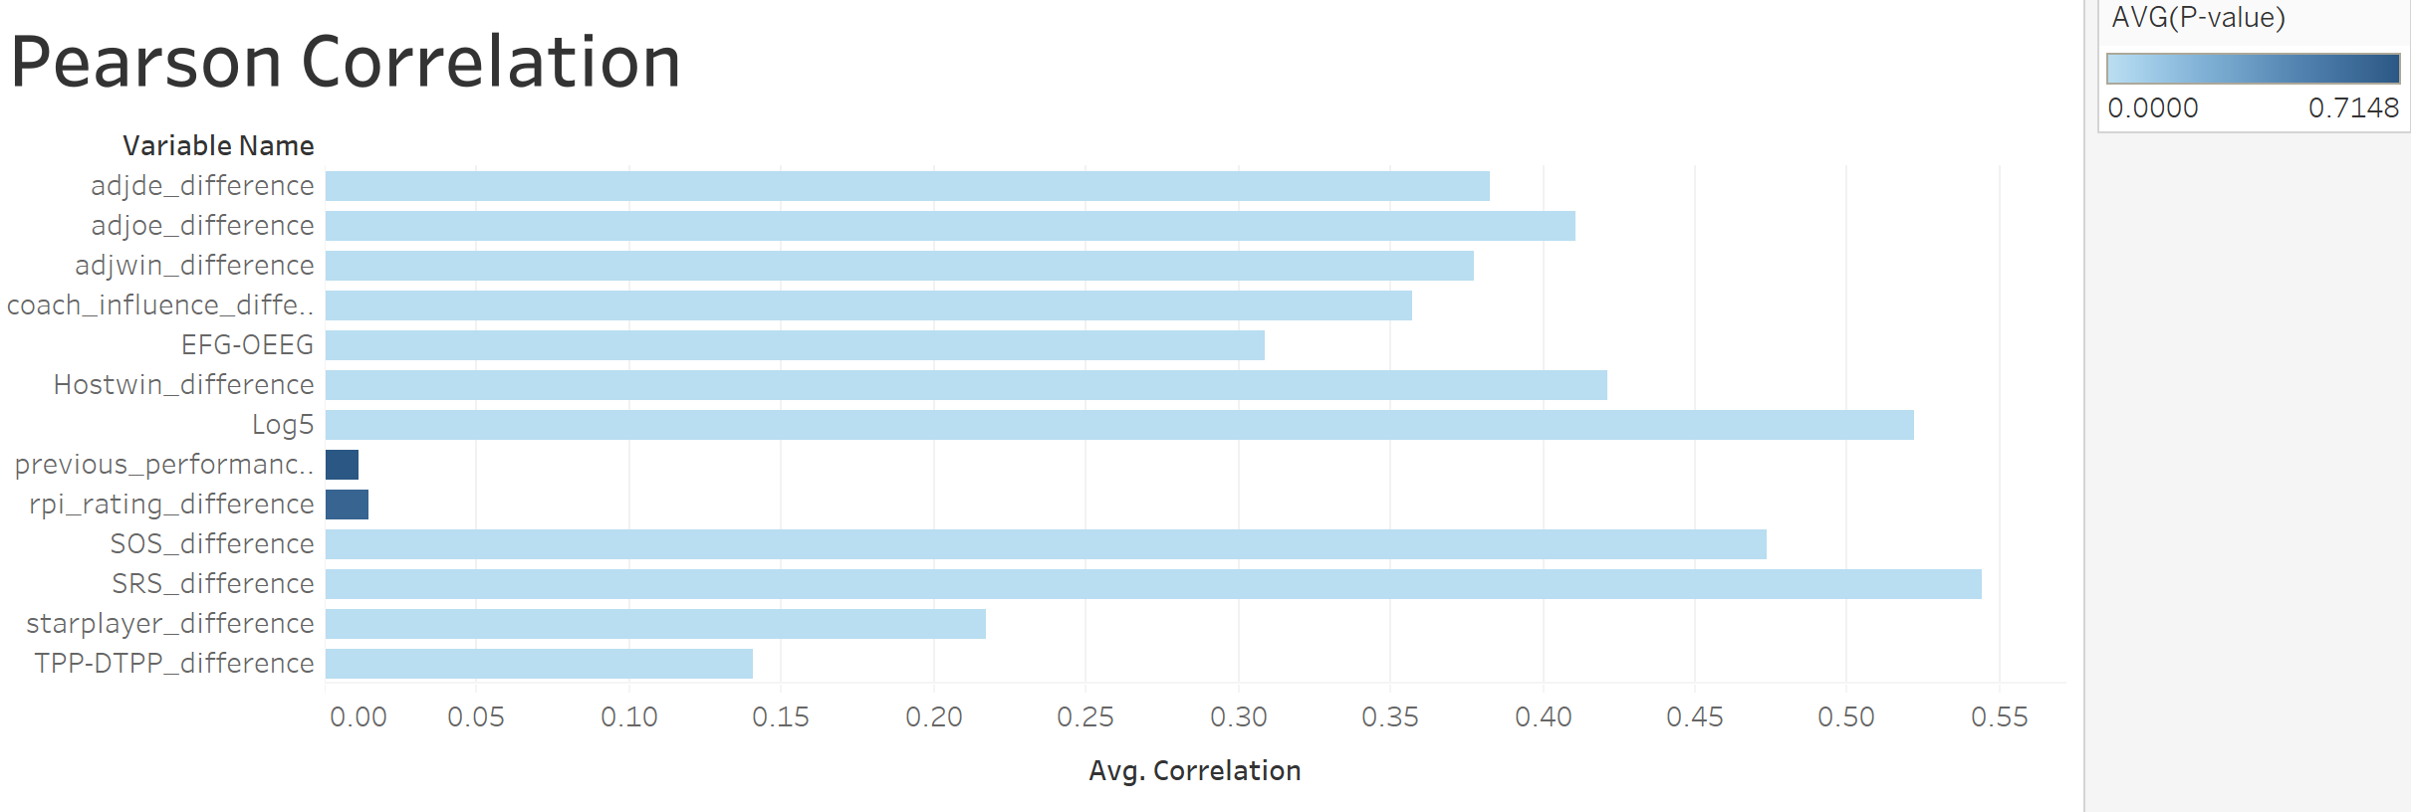
Variable selection
Use decision tree from SPSS modeler to generate first 15 important variables
Select data based on Pearson Correlation between each variable and ‘result’

Slide 7
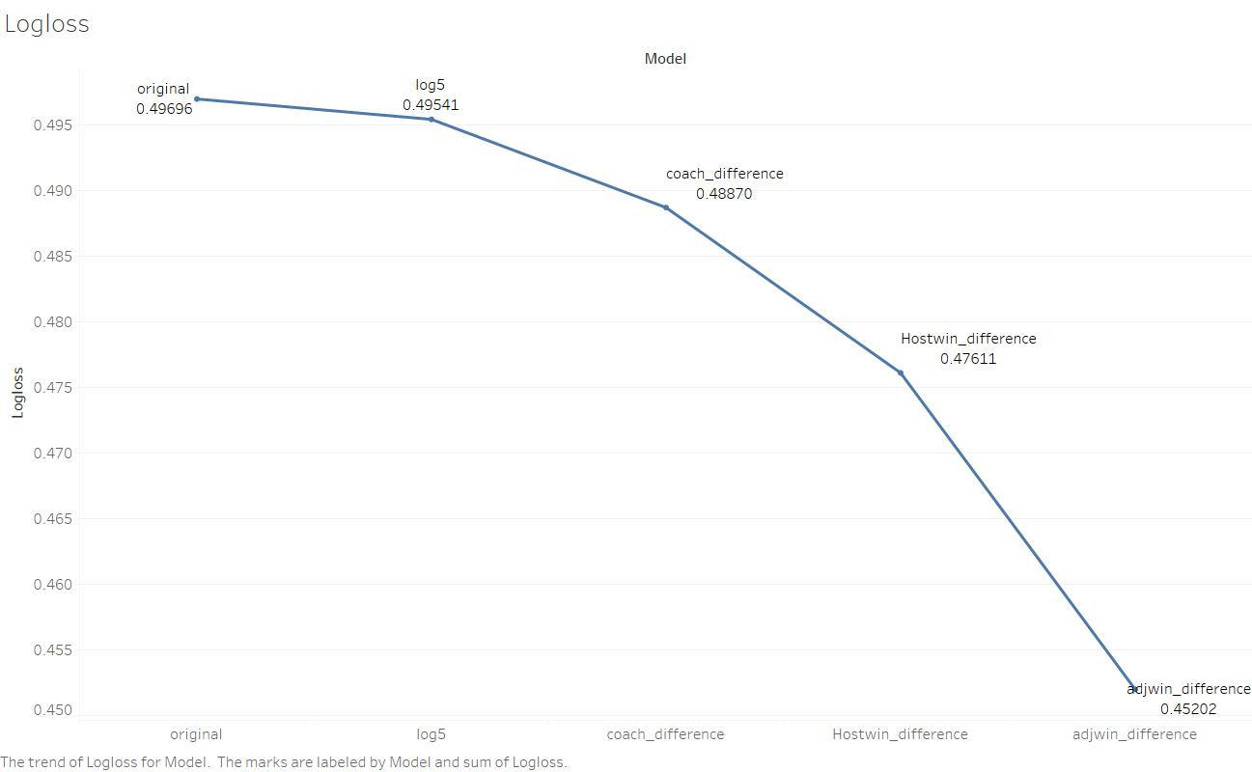
Data Processing

Slide 8
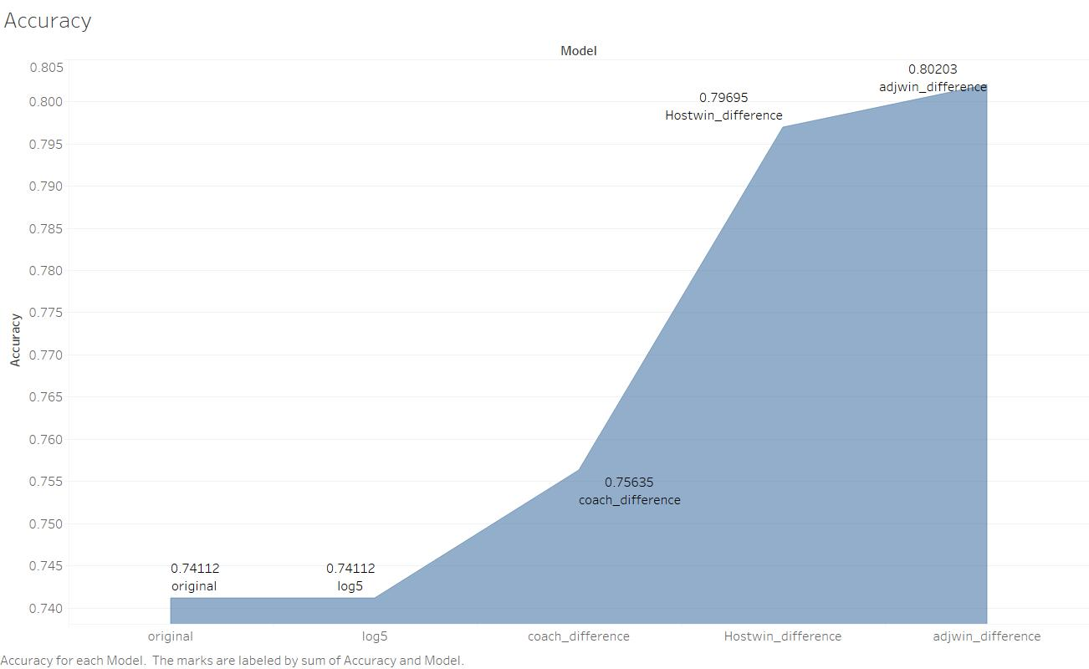
Data Processing

Slide 9
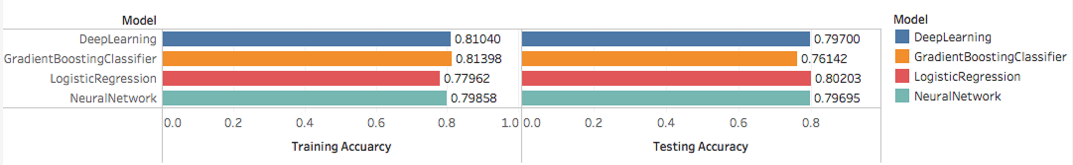
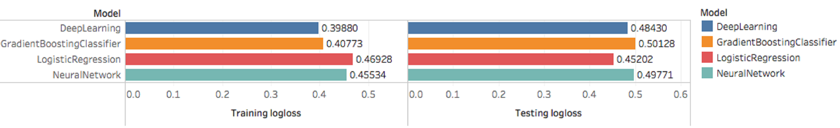
Model selection
Accuracy for each model
Logloss for each model

Slide 10
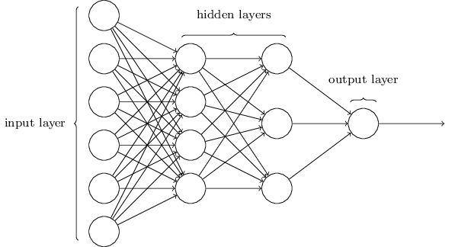

Deep Learning Model : Artificial Neural Network
Like human brains, it creates network that can learn by itself.
We choose the rectifier activation function for the hidden layers and sigmoid activation function for the output layer.
The model obtain best performance after being trained for 30 times.
Team
Variables
Win/Lose

Slide 11
Model Combination
We find Ensemble Machine Learning Algorithms in scikit-learn by using python.
We use voting function to build multiple models and simple statistics to combine our predictions from Neural Network , Gradient Boosting Classifier , Logistic Regression and Artificial Neural Network.
However, the result is not better than our original result from Logistic Regression.
Finally, we decide to use Logistic Regression as our model to generate probability and result of 2018 NCAA March Madness

Slide 12






Final Prediction
Final 4 prediction
Kentucky University vs. Xavier University
Villanova University vs. Kansas University
National Championship: Kansas University

